Slide 1

Applied Data Science Final Project
IBM/Coursera

Slide 2

Content
Introduction
Problems
Data Section
Methodology
Results
Conclusion

Slide 3
Introduction
New York City's demographics show that it is a large and ethnically diverse metropolis. It is the largest city in the United States with a long history of international immigration. New York City was home to nearly 8.5 million people in 2014, accounting for over 40% of the population of New York State and a slightly lower percentage of the New York metropolitan area, home to approximately 23.6 million. Over the last decade the city has been growing faster than the region. The New York region continues to be by far the leading metropolitan gateway for legal immigrants admitted into the United States.
For many Indian residing in the US or particularly in the New York City, its hectic to find Indian cuisine restaurant. As a result, a lot of Indian students and workers look for their home cuisine in the foreign countries, and this brings to the development of a lot of Indian restaurants in the US. For retailers, the central location and the large crowd, low neighboring restaurants provides a great business. As a result, there are many Indian cuisine restaurants in the New York city, USA and many more are being built. Opening restaurants in perfect place allows restaurants managers to earn a lot. Particularly, the location of the restaurant is one of the most important factors that determines whether the mall will be success or a failure.
3

Slide 4
Problems
Using data science methodology and machine learning techniques like clustering, this project aims to provide solutions to answer the main business question: What is best location in New York City for an Indian Cuisine?
Along with some sub-questions like:
1.Which areas have potential Indian Restaurants?
2.Which areas lacks Indian Restaurants?
3.Which is the best place to stay if you prefer Indian Cuisine?
4

Slide 5
Data Section
For this project we need the following data:
New York City data that contains list Boroughs, Neighbourhoods along with their latitude and longitude.
Data source : https://cocl.us/new_york_dataset
Description: This data set contains the required information. And we will use this data set to explore various neighbourhoods of New York City.
Indian restaurants in each neighbourhood of New York City.
Data source : Foursquare API
Description: By using this API we will get all the venues in each neighbourhood. We can filter these venues to get only Indian restaurants.
GeoSpace data
Data source:
https://data.cityofnewyork.us/City-Government/Borough-Boundaries/tqmj-j8zm
Description: By using this geo space data we will get the New York Borough boundaries that will help us visualize choropleth map.
5

Slide 6
Methodology
We begin by collecting the New York city data from the following link "https://cocl.us/new_york_dataset“
We will find all venues for each neighbourhood using Foursquare API.
We will then filter out all venues with Indian restaurant for further analysis.
Next using Foursquare API, we will find the Ratings, Tips, and Number of Likes for all the Indian Restaurants.
We will then sort Neighbourhoods and Borough the data keeping Ratings as the constraint.
Next we will consider all the neighbourhoods with average rating greater or equal 9.0 to visualize on map.
We will join this dataset to original New York data to get longitude and latitude.
Finally, we will visualize the Neighbourhoods and Borough based on average Rating using python’s Folium library.
6

Slide 7
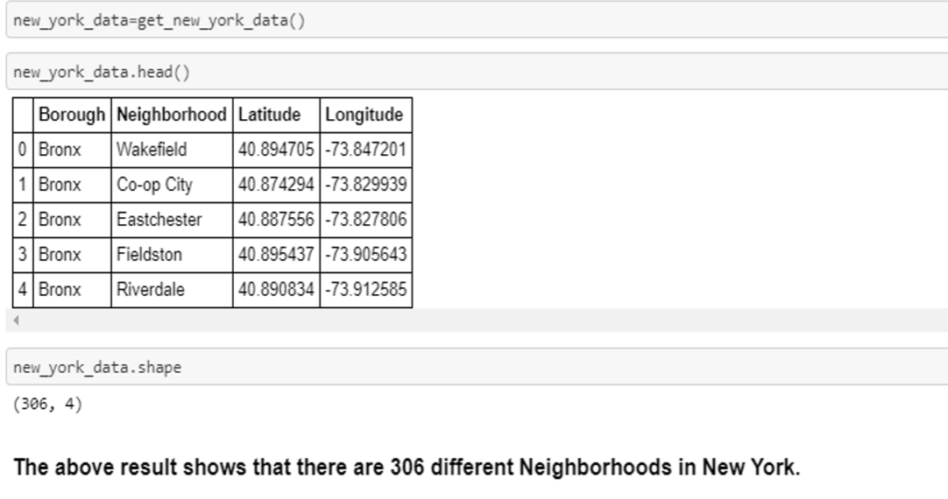
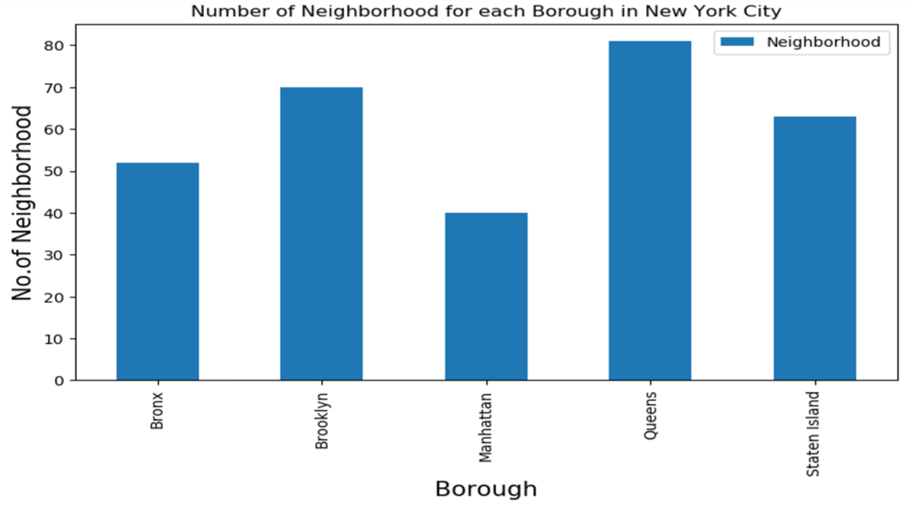
Corresponding Images
Find all venues for each neighborhood using Foursquare API
7

Slide 8
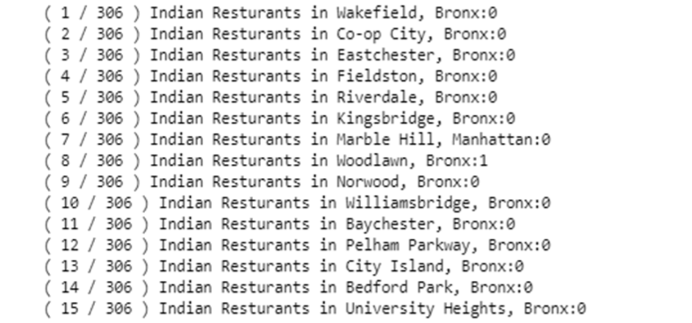
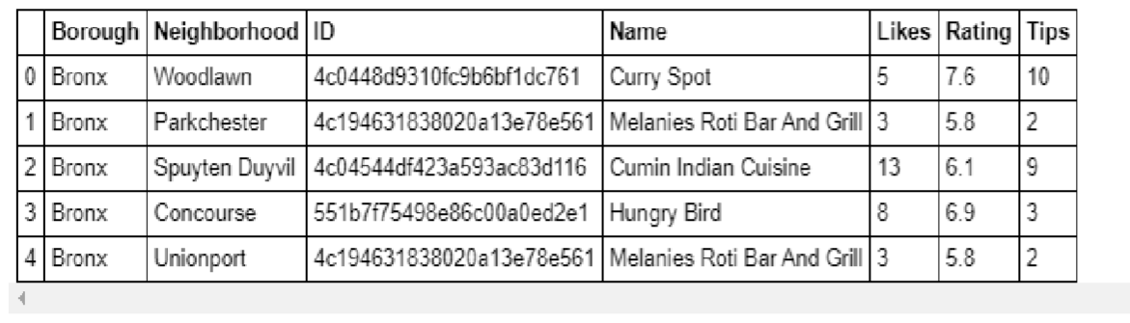
Corresponding Images
Filter out all venues with Indian restaurant for further analysis
Find the Ratings, Tips, and Number of Likes for all the Indian Restaurants.
8

Slide 9
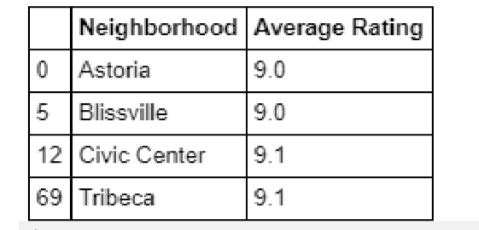
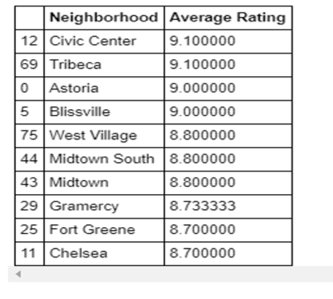
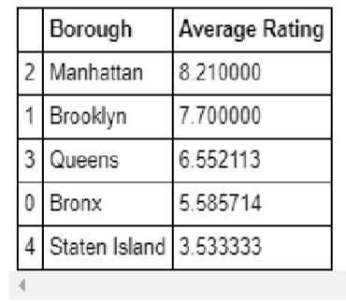
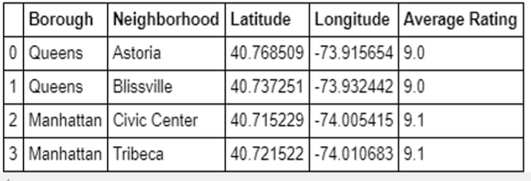
Corresponding Images
Consider all the neighborhoods with average rating greater or equal 9.0 to visualize on map
Sort Neighborhoods and Borough the data keeping Ratings as the constraint.
Join this dataset to original New York data to get longitude and latitude
9

Slide 10
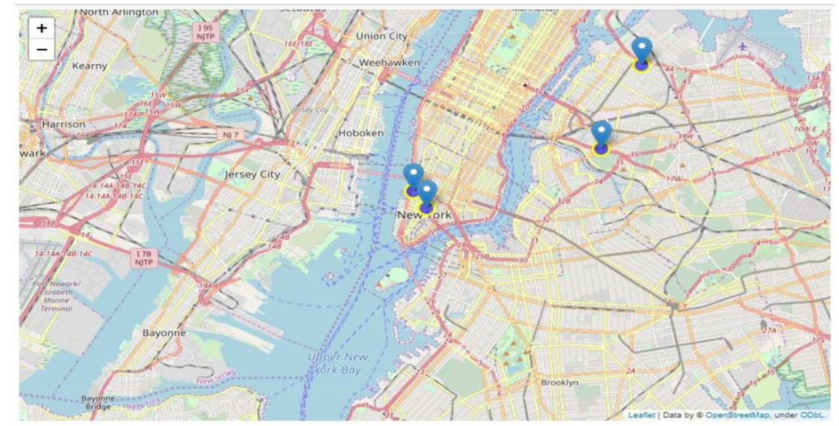
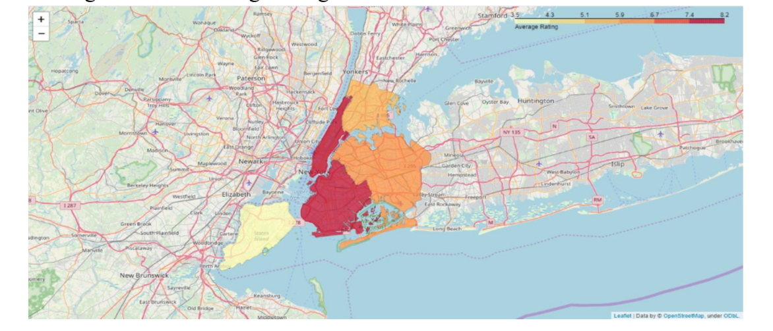
Corresponding Images
Neighborhoods based on average rating
Borough based on average rating
10

Slide 11
Results & Conclusion
Results
For Main Question: Astoria (Queens), Blissville (Queens), Civic Center (Manhattan) are some of the best neighborhoods for Indian cuisine.
1. Manhattan have potential Indian Restaurant Market.
2. Staten Island ranks last in average rating of Indian Restaurants where lacks Indian food service.
3. Manhattan is the best place to stay if you prefer Indian Cuisine.
Conclusion
In this report, I explore the Indian restaurants in New York City and successfully choose three best locations for an Indian Cuisine. The improvement lies in the preciseness of coding and more convenient logic to process.
11

Slide 12
Thanks you !
IBM/Coursera

